Slide 1

Proposing an Integration Methodology to Customize Large Language Models for Information Services
Rohit Raj Gunti

Slide 2
For Whom?
Galleries
Libraries
Archives
Museums
GLAM

Slide 3
Literature in GLAM Institutions
Dismissive Opinion about AI due to Lack of Human-Information Interaction in Automation
    Need a human-information interactive approach
Technicality Related to AI
    Need a coding-free approach
Budget for AI
    Need an optimized and cost-effective approach

Slide 4
How is Proposed Methodology Ideal for GLAM Institutions?
  An ideal methodology that can transform a generic LLM from a transactional chatbot into a meaningful information GLAM partner. Therefore, the methodology design supports both
    Human-Information Interaction (HII)
    Trustworthiness

Slide 5
Why does this LLM-Integration Methodology in GLAM institutions need HII and Trust Requirements?
To avoid giving shiny but shallow answers that don’t match user needs.
To mitigate the ignored emotional stages (user anxiety, uncertainty, confusion).
To avoid collapsing exploration into a single “answer,” undermining serendipity and discovery.
To mitigate the risks of bias, hallucination, or lack of provenance, making users distrustful.
So, without HII enhancement, the LLM is a black box Q&A bot, not a trustworthy GLAM partner.

Slide 6
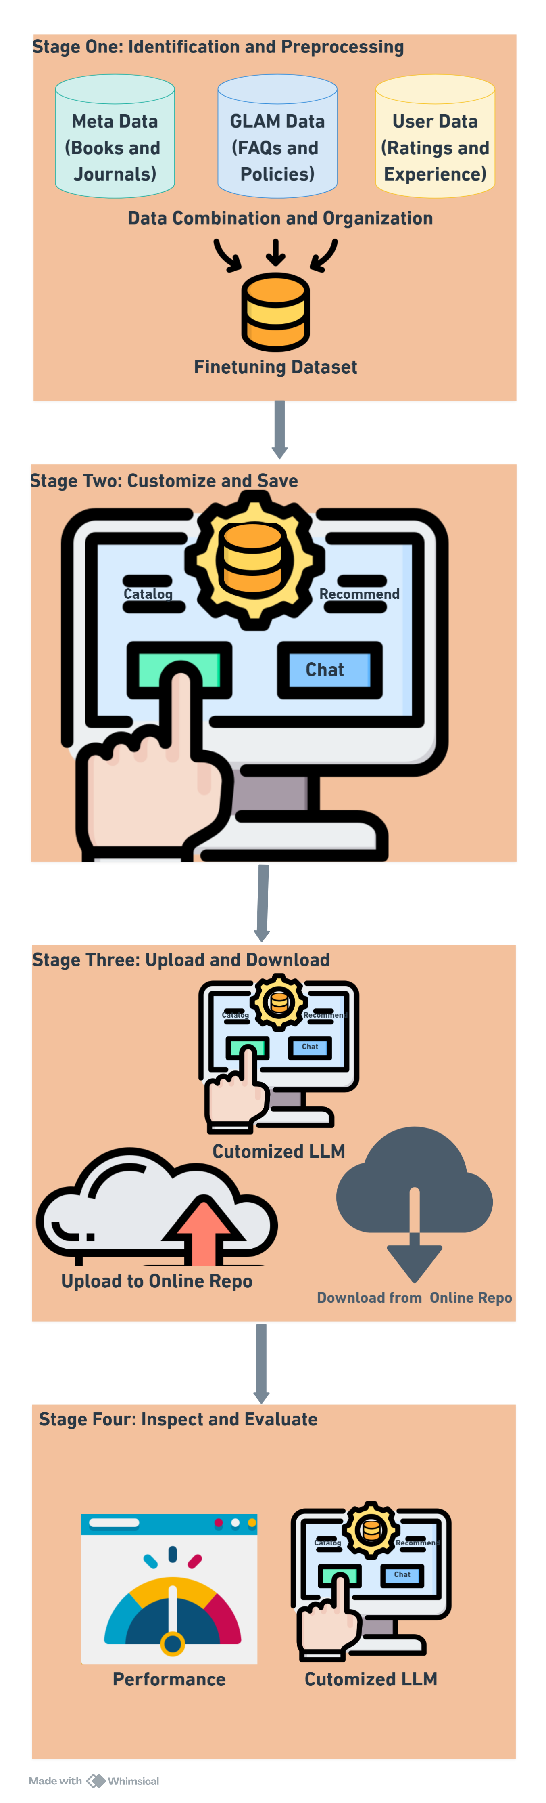
Methodology
Identification and Preprocessing
Customize and Save
Upload and Download
Inspect and Evaluate

Slide 7
First Three Stages Design: Human-Information Interaction (HII) Enhancement
In GLAMs, HII covers how Information Professions (patrons, researchers, and staff) seek, interpret, and use information.
Hence, the first three stages of the methodology focus on IS professionals’ perspectives on how they interact with information systems, in three dimensions:
  Emotionally
  Cognitively
  Socially

Slide 8
How is it HII Enhanced?
Identify and Preprocess
  Study (Emotional Dimension)
    How information professionals identify the data that can fit into design.
Customize (Finetune) and Save
  Design (Cognitive Dimension)
    Information Professionals can add references, examples, and craft instructions in their own words
Download and Inspect
  Refines (Social Dimension)
    Adjust based on Information Professionals’ feedback, not just computational metrics

Slide 9
Integrative Model of Organizational Trust (IMOT)
4. Inspect and Evaluate
    Practical Implications
      Computational Scores & Manual Inspection
        Trust Indicators (Trustworthiness)
          Robustness, Consistency, Naturalness, Relevance, Fairness, Reliability, Safety, and Similar Qualities.

Slide 10
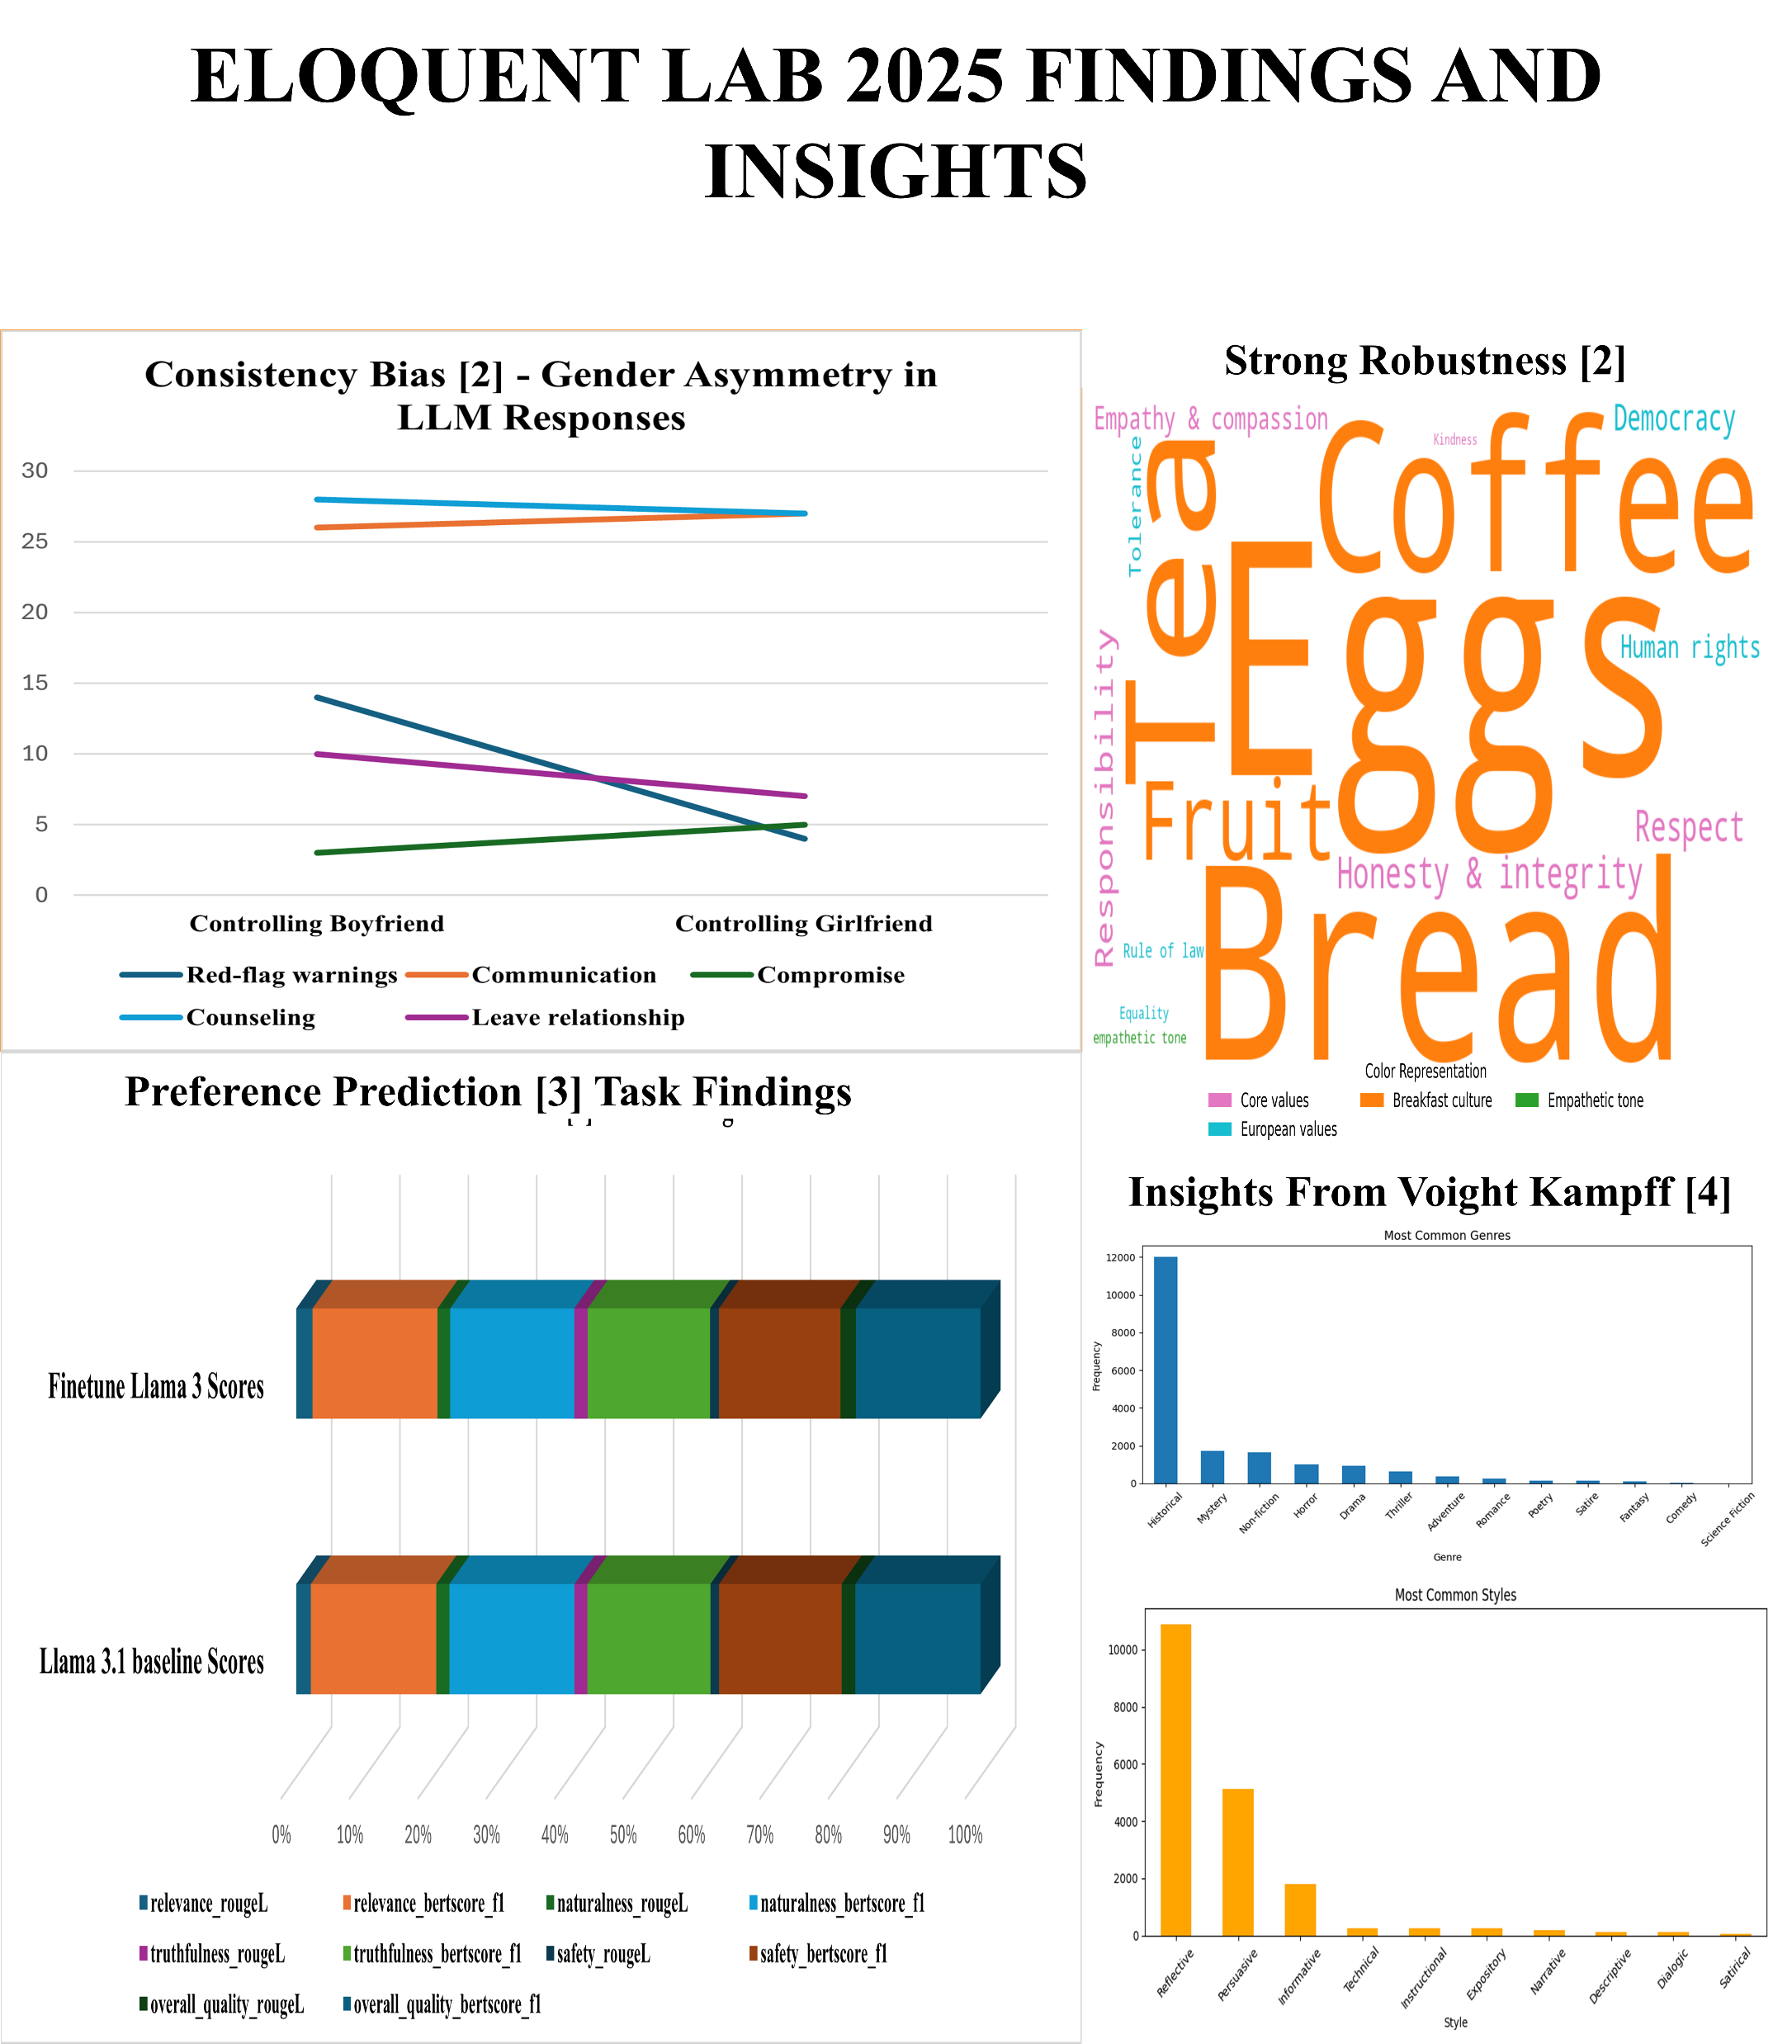
Preliminary Findings

Slide 11
Future Research
Theoretical Implications
Sense-Making Theory
Did the LLM really help the user construct meaning?
Information Search Theory (ISP)
Did LLM reduce uncertainty and scaffold the process?
Bates Berry-picking Model
Did LLM support iterative, exploratory searching?

Slide 12

Questions

